Slide 1

Examining & Re-Evaluating Legal Authorities for TB Control
Clifford M. Rees, JD
May 31, 2012

Slide 2
Basics of Public Health Law
Inter-Jurisdictional Legal Mechanisms Applicable to TB Control

Slide 3
Basics of Public Health Law
5 Levels of Jurisdiction
International
Federal
State
Local
Tribal

Slide 4
Basics of Public Health Law
Laws are rules that govern our conduct.
General Sources of Law:
Constitution (federal/state)
Common Law (federal/state)
Statutes (federal/state)
Rules/Regulations/Ordinances (federal/state/local)
Executive Orders (federal/state)

Slide 5
Basics of Public Health Law
State/Local Health Law Powers
U.S Constitution - “Police Powers”
10th Amendment to the U.S. Constitution
Powers not given to the Federal Government
are reserved to the States
State authority - Intrastate issues – TB Control
    Infectious Disease Control Measures
    Public Health Treatment Facilities
    Licensure of Public and Private Health Facilities
Notes:
Other State Public Health Authorities:
Licensure of Individual Health Providers
2. Administration of benefit programs such as child nutrition, family planning, cancer detection, tobacco cessation, school health clinics

Slide 6
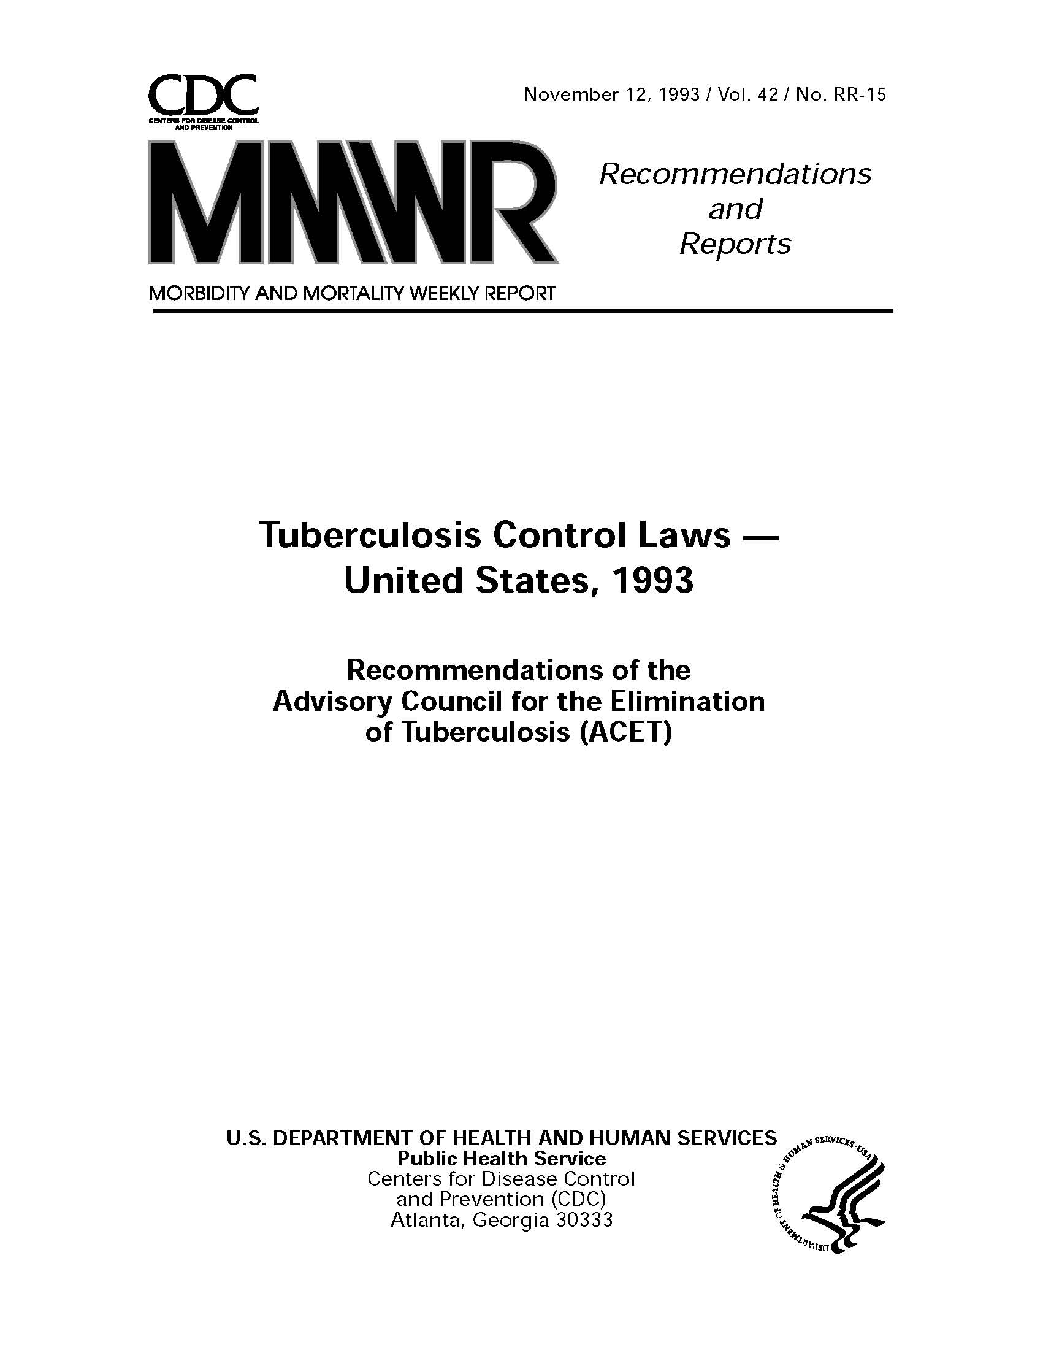
Basics of Public Health Law
Notes:
State TB laws vary widely – some are TB specific (like CA) and some are general communicable disease laws (like NM)
Cf. The Southern US Border States: California, Arizona, New Mexico, Texas
October 3, 2007 TB Legal Forum in Phoenix
State TB Caselaw
City of Newark v. J.S., 279 N.J. Super, 652 A. 2d 265, 1993 N.J. Super. LEXIS (N.J. Super. Ct. Law Div. 1993).
Sovannarath v. Hadden, 95 Cal. App. 4th 1115, 116 Cal. Rptr. 2d 7, 2002 Cal App. LEXIS 42 (Court of Appeals of California, Fifth Appellate District, 2002).
City of Milwaukee v. Ruby Washington, 2007 WI 104, 735 N.W. 2d 111, 2007 Wisc. LEXIS 434 (Supreme Court of Wisconsin, 2007).

Slide 7
Basics of Public Health Law
State/Local Health Law Power
New Mexico State Statute
Public Health Act, Sections 24-1-1., et seq., NMSA 1978 (from Laws 1919, Chapter 85, Section 10)
  24-1-3.C.; ... to investigate, control and abate causes of disease, especially epidemics, sources of mortality and other conditions of public health.
  24-1-3.D.; … to establish, maintain and enforce isolation and quarantine
  24-1-3.E.; … to close any public place and forbid gatherings of people when necessary for the protection of public health
Notes:
Notice the Act was enacted in 1919 in the aftermath of the Great Influenza Pandemic of 1918-1919
The duties of the original NM Department of Health created in 1919 are almost exactly the same in the NM Public Health Act today at Section 24-1-3, et seq., NMSA 1978.

Slide 8
Basics of Public Health Law
State/Local Health Law Power
New Mexico State Statutes & Rules
  Section 24-1-15, NMSA 1978 - “Reporting of Contagious Diseases”
    Subsection A. – Reporting Requirement
  Rule – 7.4.3 NMAC, “Control of Disease and Conditions of Public Health Significance”
    Subsections B. – L. - Due Process procedures to detain a person infected with a threatening communicable disease

Slide 9
Basics of Public Health Law
State/Local Health Law Power
New Mexico State Statutes:
Protocol for Management of Infectious Forms of Tuberculosis,
Section 24-1-15.1, NMSA 1978 (Laws of 2009, Chapter 174)
Public Health Emergency Response Act, Sections 12-10A.-1., et seq., NMSA 1978, (Laws of 2003, Chapter 218, as amended)
New Mexico Legislative Council Service website - www.nmlegis.gov/lcs> Other Resources>Statutes

Slide 10
Basics of Public Health Law
Federal Health Powers
U.S. Constitution (Article I, Section 8)
Commerce Clause – Interstate
Tax and Spend Clause - General Welfare
Notes:
Interstate Commerce, International Borders, Federal Territories and Facilities, Native American Tribes and Pueblos
1824 – Gibbons v. Ogden (first recognition of public health police powers in U.S. Supreme Court decision)

Slide 11
Basics of Public Health Law
Federal Health Powers
Federal Statutes (USC)
42 USC Section 264
Federal Regulations (CFR)
Quarantine Authority (42 CFR Parts 70 and 71)
Federal Executive Orders
EO 13375 (April 1, 2005)
Amending EO 13295 (April 4, 2003) Relating to Certain Influenza Viruses and Quarantinable Communicable Diseases
Notes:
Health Insurance Portability and Accountability Act of 1996 – 42 USC Part 1320d and its Privacy Rule (35 CFR Parts 160 and 164)
EMTALA, ERISA, ADA, etc.
Public Health Benefits: Medicare (Prescription Rx Part D), Medicaid, SCHIP,
Public Health Service Act
CDC can intervene if the States are not adequately protecting the public’s health (Interstate Commerce Clause)

Slide 12
Basics of Public Health Law
Federal Quarantinable Diseases
Smallpox
Cholera
Plague
Viral Hemorrhagic Fevers
Infectious Tuberculosis
Yellow Fever
Diphtheria
SARS
Novel Influenza Virus

Slide 13
Basics of Public Health Law
Tribal Health Powers
Navajo Nation: Adopted the Health Commitment Act of 2006, Title 13 Navajo Nation Code, Section 2101, et seq., providing a mechanism for the health commitment of individuals for treatment in the least restrictive setting
If Tribal governments do not have their own laws, they may follow federal or state laws
25 USC Section 198, 25 USC 231, 42 USC Section 243,
42 USC Section 264
Notes:
Relevant Federal laws may be under the authority of IHS, HHS, Interior, etc.

Slide 14
Basics of Public Health Law
International Health Powers
  International Health Regulations (IHR)-2005
  Defines Public Health Emergency of International Concern (PHEIC)
  Requires response on a time-sensitive basis
  Imposes requirements for sharing information between member countries
  Implemented under domestic laws for each country

Slide 15
U.S. will implement IHR under principles of federalism
Basics of Public Health Law
International Health Powers
    State and Local public health legal
    authorities will be honored as well as
    Federal legal authorities

Slide 16
Inter-Jurisdictional Legal Authorities
United States Constitution, Article I, Section 8 – Congress shall have the power to regulate Commerce with foreign nations, among the several States and with Indian Tribes;
United States Constitution, Article I, Section 10 – No State shall enter into any Treaty, Alliance or Confederation; No State shall, without the consent of Congress . . . enter into any Agreement or Compact with another State, or with a foreign power . . .
Notes:
Necessity for planning for inter-jurisdictional issues

Slide 17
Options for U.S. International Agreements:
Inter-Jurisdictional Legal Authorities
Formal treaties between nations, signed by the President with advice and consent of Congress.
Agreements negotiated by the US State Department based on its statutory authority.
Non-binding agreements that do not require involvement by the US State Department.

Slide 18
Examples of Existing International Agreements
Inter-Jurisdictional Legal Authorities
Pacific Northwest Emergency Management Arrangement
  Pacific Northwest States and Western Canadian Provinces (April, 1996)
International Emergency Management Assistance Memorandum of Understanding
  New England States and Eastern Canadian Provinces (July, 2000)
Great Lakes Border Health Initiative (Fall 2004)
Notes:
Per CDC Public Health Law News, December 19, 2007 (http://www2a.cdc.gov/phlp/)
“On December 17, 2007, the U.S. House of Representatives passed House Joint Resolution 59, a companion to U.S. Senate Resolution 13, which passed on October 2, 2007. The Joint Resolution grants Congressional consent to the International Emergency Management Assistance Memorandum (IEMAMOU), a mutual aid agreement executed in 2000 by Conn., Me. Mass., NH, RI and Vermont and the Canadian Provinces of New Brunswick, Newfoundland, Nova Scotia, Prince Edward Island and Quebec.”

Slide 19
Types of Agreements
Inter-Jurisdictional Legal Authorities
International Treaties
Interstate Compacts
Mutual Aid Agreements
Memoranda of Understanding/Agreement -Joint Powers Agreements
Professional Services Agreements

Slide 20
Inter-Jurisdictional Legal Authorities
 | Federal | State | Local | Tribal | International
Federal | Federal Statute Homeland Security Presidential Directive 8 | Federal Statute Grants -Stafford Act | Federal Statute Grants -Stafford Act | Treaties Federal Statute Grants | Treaties (binding) Article 1, Section 10, U.S. Const. Federal Statute IHR
State | Federal Statute Grants Stafford Act JPA | EMAC (Emergency) Mutual Aid (non-emergency) JPA PSA | Mutual Aid MOU/MOA JPA PSA | Mutual Aid MOU/MOA JPA PSA | Treaties (non-binding) Federal Statute IHR Stafford Act
Local | Federal Statute Grants -Stafford Act | Mutual Aid MOU/MOA JPA PSA | Mutual Aid JPA PSA | Mutual Aid JPA PSA | Mutual Aid (non-binding)
Tribal | Treaties Federal Statute Grants | Mutual Aid MOU/MOA JPA PSA | Mutual Aid JPA PSA | Mutual Aid | Treaties?
Inter- national | Treaties (binding) Article 1, Section 10, U.S. Const. Federal Statute IHR | Treaties (non-binding) Federal Statute IHR Stafford Act | Mutual Aid (non-binding) | Treaties? | Treaties IHR
Developed by Clifford M. Rees, JD

Slide 21
Example of mechanisms to transfer TB patients between U.S. jurisdictions
Inter-Jurisdictional Legal Authorities
Legal agreements for cross-jurisdictional use of TB residential treatment facilities
  Between Navajo Nation and New Mexico state government
  Between New Mexico and Texas state governments

Slide 22
Future Directions
Inter-Jurisdictional Legal Authorities
New England Compact on Involuntary Detention for TB Control
  The National Center for Interstate Compacts-Council of State Governments-http://www.csg.org/
House Bill 709, New Mexico Legislature, 2005 Regular Session
Interstate Compact on Threatening Communicable Disease (Died on adjournment)
Notes:
Hold a binational legal forum with Mexican counterparts
Continue meeting with this group/create website
Engage border health partner organizations
Engage entities involved in preparedness and other issues regarding infectious diseases of public health significance
Review cross jurisdictional agreements
Review considerations of legal issues with regard to least restrictive standard
Support legal language for TB to be considered an active infectious disease of public health importance until cured
Identify interstate and binational legal issues needing further study
Support the ability of tribal governments to have full participation in TB legal determination
Promote tribal inclusion in border TB control activities and planning
Establish mechanisms for sharing information across state and national borders
Expand epidemiologic surveillance initiatives to the ten U.S. and Mexican border states
Promote binational case management and collaborations on contact investigations
Review whether patients in federal custody can be transferred to state or local public health jurisdiction for treatment and case management
Consider mechanism to delay deportation of patients with active TB until treatment is completed
Address resource limitations
Count all TB cases managed in funding determinations

Slide 23
Future Directions (Continued)
Inter-Jurisdictional Legal Authorities
Model/Uniform Infectious Disease Laws
  Model State Emergency Health Powers Act (2001)
  “Turning Point” Model State Public Health Act (2003)
  Uniform Law ?

Slide 24
Future Directions (Continued)
Inter-Jurisdictional Legal Authorities
Security and Prosperity Partnership (SPP)
  Mutual Assistance Agreement- Nov. 1, 2007
US-Mexico Border Health Commission
  International TB Legal Forums -2010 (El Paso) and 2011 (San Diego)

Slide 25
DISCUSSION
TB SCENARIOS

Slide 26

The Network for Public Health Law
The Network uses law to improve the public’s health.
Through its 5 regional offices, the Network provides technical assistance, training, and other efforts to individuals and organizations.
Public health lawyers, practitioners, students, and others committed to applying law to improve the public’s health can join the Network at www.networkforphl.org.
Notes:
The map serves as a hyperlink to the network’s webpage.

Slide 27
Public Health Legal Support
At no cost, the Network provides:
  Insightful legal assistance
  Helpful resources
  Opportunities to build connections
With a single point of entry to experts on a wide-range of topics, it’s practical, reliable and seamless.

Slide 28
Who can use the Network
Anyone committed to public health can join the Network:
  Local, state, tribal and federal public health officials
  Public health practitioners
  Attorneys
  Policy-makers
  Advocates

Slide 29
Public Health Topics
Working with experts around the country, the Network provides support on a variety of topics:
  Cross-border public health
  Emergency legal preparedness and response
  Environmental public health
  Food safety
  Health reform
  Health information data sharing
  Injury prevention and safety
  Obesity prevention
  Public health agency accreditation and shared service delivery
  Public health statutes and regulatory information
  Tobacco control
  Tribal public health law
  And other topics

Slide 30
Legal Technical Assistance
Legal assistance can include:
  Strategizing about potential legal options
  Help finding experts, resources and tools
  Support to develop, implement and enforce legislation, statutes or regulations
Technical assistance does not include providing legal advice or representation.

Slide 31
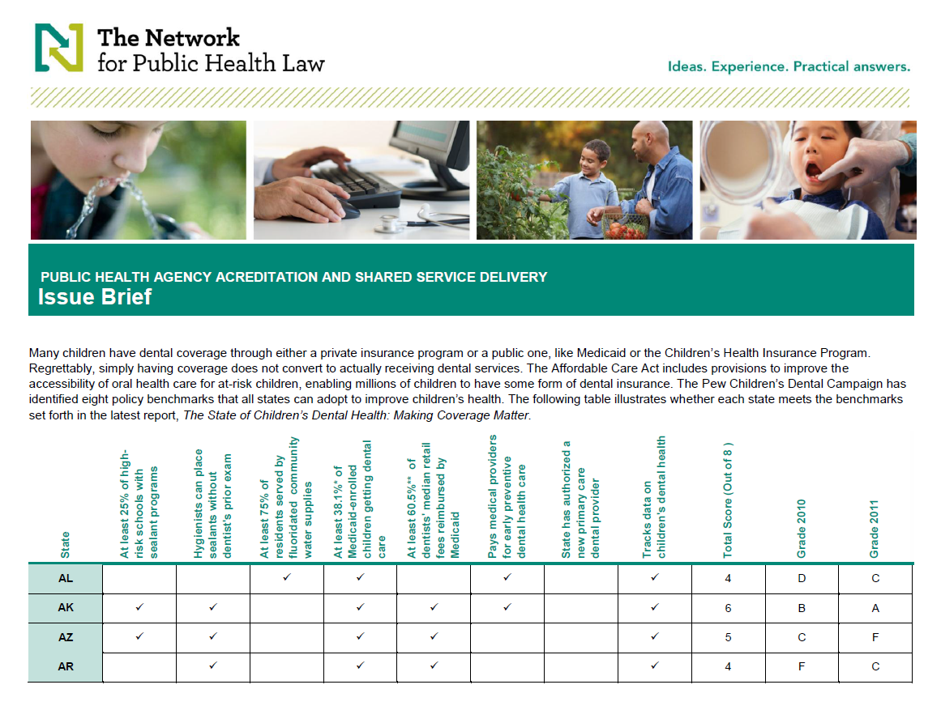
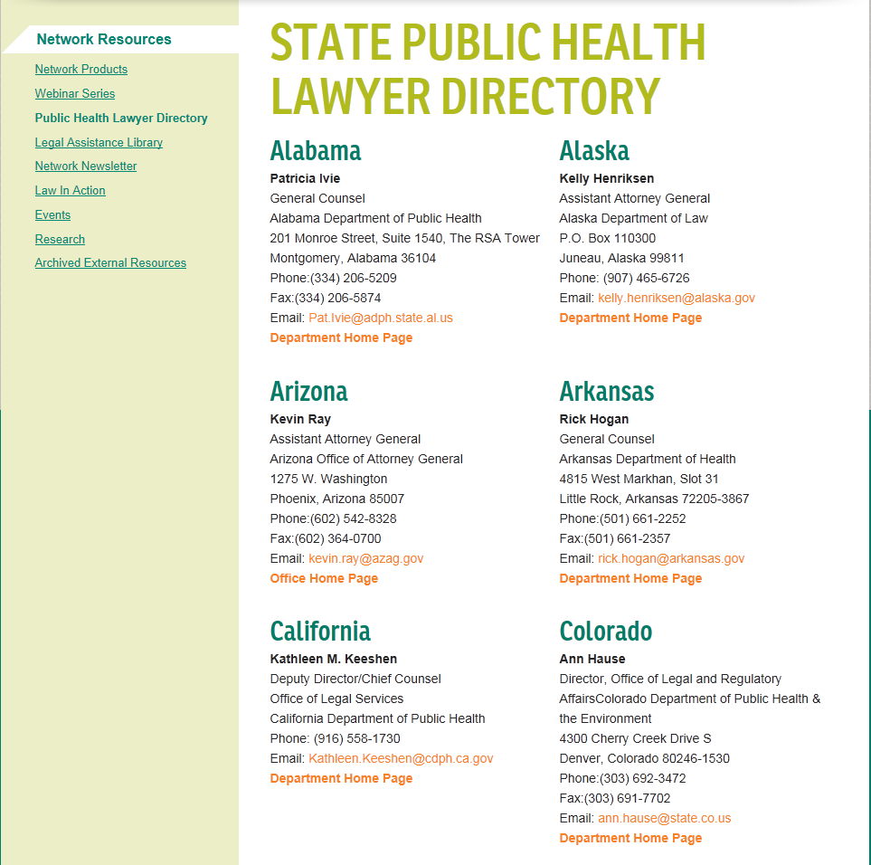
Access Helpful Resources
  Network products, such as fact sheets, tables of state laws, legal briefs and more
  Monthly webinar series
  Public health lawyer directory
  Library of legal assistance questions and answers
  External resources
  Network newsletters
  Events

Slide 32

Join the Network at no cost:
  Get the latest information on public health law
  Connect with others in the Network
  Share your public health law knowledge and experiences
  Get help developing, implementing and enforcing public health laws
  Access legal assistance and resources

Slide 33
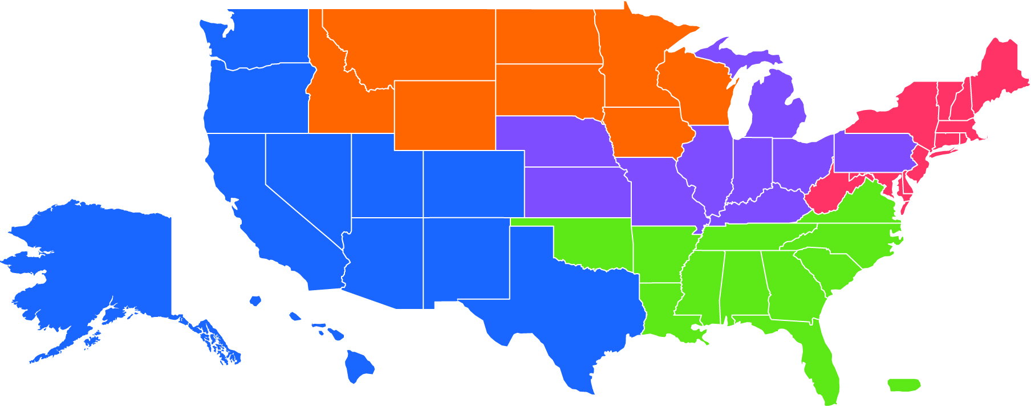
National Scope with Local Expertise
  Provides support across the country
  Divided into 5 Regions to provide local and state support
  Contact your Region for assistance

Slide 34
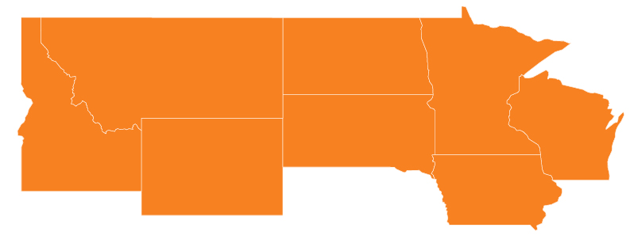
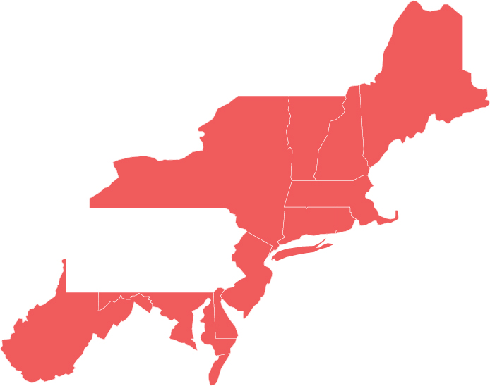
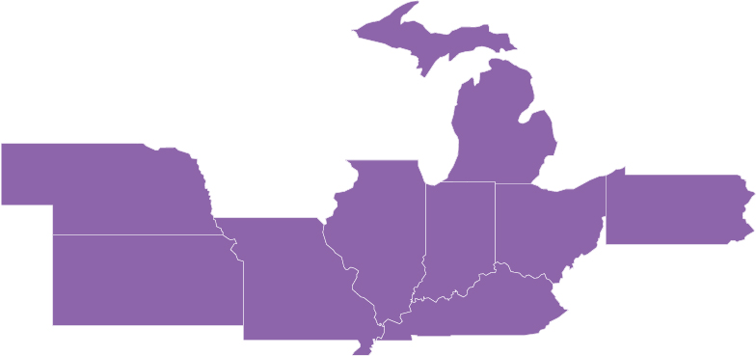
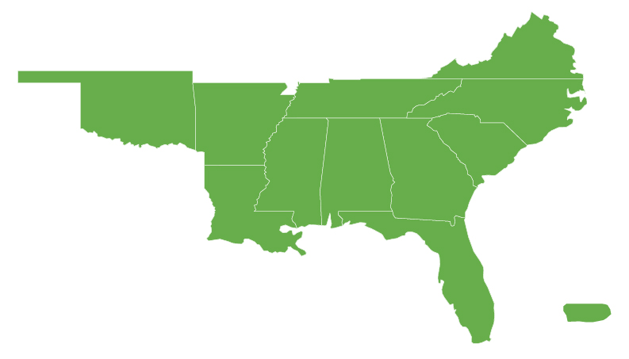
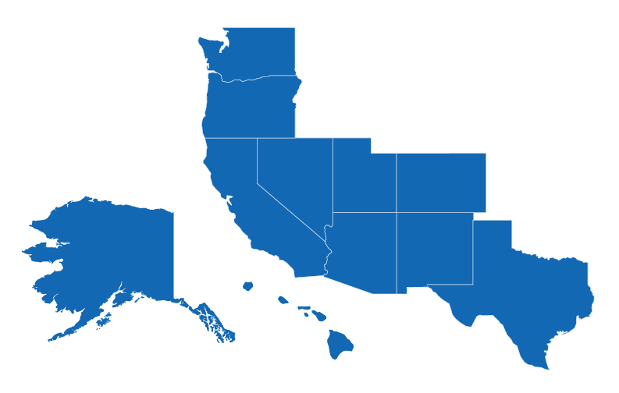
Five Regions
National Coordinating Center/Northern Region
  Public Health Law Center at William Mitchell College of Law
Eastern Region
  The University of Maryland School of Law working with the John Hopkins Bloomberg School of Public Health
Mid-States Region
  University of Michigan School of Public Health
Southeastern Region
  UNC Gillings School of Global Public Health working with the National Health Law Program
Western Region
  Sandra Day O’Connor College of Law at Arizona State University working with the University of New Mexico School of Law

Slide 35
The Network - Western Region
Population
California (36.9 mill)
Texas (24.7 mill)
3. Washington (6.6 mill)
Arizona (6.6 mill)
Colorado (5.0 mill)
Oregon (3.8 mill)
7. Utah (2.7 mill)
Nevada (2.6 mill)
New Mexico (2.0 mill)
Hawaii (1.3 mill)
Alaska (0.7 mill)
Total: 93,285,323
Washington
Hawaii
Alaska
Oregon
Nevada
Utah
Colorado
California
Arizona
New Mexico
Texas
Source: US Census Bureau [http://www.census.gov/popest/states/NST-ann-est.html]
Current as of July 1, 2009

Slide 36

Western Region Leaders
James G. Hodge, Jr., J.D. LL.M., Director
Director, Public Health Law and Policy Program of Arizona State University
Lincoln Professor of Health Law and Ethics, ASU Sandra Day O’Connor College of Law
Vice-chair, ABA Public Health Interest Group
Senior Scholar, Centers for Law and the Public’s Health: A Collaborative at Johns Hopkins and Georgetown Universities
jhodge@networkforphl.org
Emergency Preparedness
Notes:
Define public health law and give examples to show the lasting impact law can have on a public health issue.
36

Slide 37

Western Region Leaders
Clifford M. Rees, JD, Practice Director
Senior Staff Attorney, University of New Mexico Institute of Public Law, UNM School of Law
Research Assistant Professor, Department of Emergency Medicine, UNM School of Medicine
Legislative Analyst, New Mexico Senate Public Affairs Committee
Staff Attorney (retired), New Mexico Department of Health
crees@networkforphl.org
Tribal Public Health Law

Slide 38
Funded By
Initial funding of the Network is provided by the Robert Wood Johnson Foundation

Slide 39



How Can the Western Region Assist You?
Technical Assistance
Training/Teaching
Connecting you to scholars, practitioners, and policy-makers in public health and law

Slide 40
Menu of Potential Tools
Options for Providing Technical Assistance
Model legislative language
Legal best practices
Models notices/guidelines
Sample legal guidance letters
Memorandum of Understanding
Training guides
Specific legal memoranda
Tailored legal outlines
Direct legal guidance
Legal fact sheets
Frequently Asked Questions
Legal snapshots
Legal decision trees
Other translational documents
Notes:
40

Slide 41
How Do I File a Technical Assistance Request?
Option 1:
Submit a request via the Web at
http://www.networkforphl.org
Step 1:
Submit a Request for Technical Assistance
Option 2:
Call the Western Region Office M-F from 9am – 5pm (AZ time) at
(480) 727-2092
Option 3:
E-mail the Western Region Office at
dorenstein@networkforphl.org

Slide 42
Our Role in Providing Technical Assistance
The Network and the Western Region seek to facilitate and supplement the legal activities of customers and partners within the limits of our resources.
It is not our objective to:
  Replace the specific guidance of legal counsel for an agency, department, or organization
  Supersede a legal counsel’s opinion or guidance
  Resolve conflicts between persons within the agency, department, or organization, or between persons in different jurisdictions

Slide 43

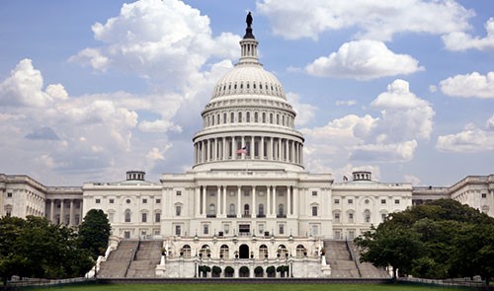
Specific Limitations on Technical Assistance
The Network does not provide legal advice, including:
Directly representing an organization or individual in court or any legal action
Giving a specific legal opinion that applies to or interprets laws to a specific factual situation pursuant to an attorney/client relationship
The Network also does not engage in any lobbying activities

Slide 44

Specific Limitations on Technical Assistance
The Network - Western Region can be your partner
But not your lawyer or law firm

Slide 45

Contact the Network
  Visit www.networkforphl.org
  Call or email us at the Western Region anytime from 9 a.m. to 5 p.m. (AZ time)
      dorenstein@networkforphl.org
      (480) 727-2092

Slide 46
Acknowledgements
Diana Schneider, DrPH, MA
Senior Epidemiologist
U.S. Immigration and Customs
Enforcement, DHS
Gary Simpson, MD
Dan Stier, JD
Dan Reyna, MSS, MPA

Slide 47
For more information:
Clifford M. Rees, JD
Practice Director, Western Region
The Network for Public Health Law
UNM School of Law
Institute of Public Law
Albuquerque, New Mexico USA
505-231-7190
crees@networkforphl.org

